Slide 1
Machine Learning An Alogrithm Persepective
Second Edition
by Stephen Marsland

Slide 2
CHAPTER 2 Preliminaries
two purposes:
to present some of the overarching important concepts of machine learning,
and to see how some of the basic ideas of data processing and statistics arise in machine learning.

Slide 3
2.1 SOME TERMINOLOGY
Inputs
An input vector is the data given as one input to the algorithm.
Written as x, with elements x_{i}, where i runs from 1 to the number of input dimensions, m.
dimensionality of the input, the number of elements in the input vector
Weights w_{ij} ,
are the weighted connections between nodes i and j.
For neural networks these weights are analogous to the synapses in the brain. They are arranged into a matrix W.
Outputs
The output vector is y, with elements y_{j} , where j runs from 1 to the number of output dimensions, n.
y(x,W) that the output depends on the inputs to the algorithm and the current set of weights of the network.

Slide 4
Targets
The target vector t, with elements t_{j} , where j runs from 1 to the number of output dimensions, n,
are the extra data that we need for supervised learning,
Activation Function
For neural networks, g(·) is a mathematical function that describes the firing of the neuron as a response to the weighted inputs,
such as the threshold function
Error E,
a function that computes the inaccuracies of the network as a function of the outputs y and targets t.

Slide 5
2.1.1 Weight Space
In particular, we can plot some of the parameters of a machine learning algorithm.
particularly useful for neural networks
treat the weights that get fed into one of the neurons as a set of coordinates
in what is known as weight space

Slide 6
In weight space
we can talk about how close together neurons and inputs are
since we can imagine positioning neurons and inputs in the same space
input space and weight space will have the same dimension
so we can plot the position of neurons in the input space.
This gives us a different way of learning, since by changing the weights we are changing the location of the neurons in this weight space.
So we can use the idea of neurons and inputs being ‘close together’ in order to decide
when a neuron should fire and when it shouldn’t.
If the neuron is close to the input in this sense then it should fire, and if it is not close then it shouldn’t.
weight space can be helpful for
what effect the number of input dimensions can have

Slide 7
2.1.2 The Curse of Dimensionality
as the number of dimensions increases, the volume of the unit hypersphere does not increase with it.
The unit hypersphere is
the region we get if we start at the origin (the centre of our coordinate system) and draw all the points that are distance 1 away from the origin.
the size of the unit hypersphere for the first few dimensions
Dimension | Volume
1 | 2
2 | 3.1416
3 | 4.1888
4 | 4.9348
5 | 5.2636
6 | 5.1677
7 | 4.7248
8 | 4.0587
9 | 3.2985
10 | 2.5502

Slide 8
when the number of dimensions is above about 20, the volume is effectively zero.
the formula for the volume of the hypersphere of dimension n as
v_{n} = (2π/n)v_{n−2}.
So as soon as n > 2π, the volume starts to shrink.
The curse of dimensionality will apply to our machine learning algorithms
because as the number of input dimensions gets larger, we will need more data to enable the algorithm to generalise sufficiently well.

Slide 9
2.2 KNOWING WHAT YOU KNOW: TESTING MACHINE LEARNING ALGORITHMS
test set
we use them to decide how well the algorithm has learnt.

Slide 10
2.2.1 Overfitting
we need to make sure that we do enough training that the algorithm generalises well.
In fact, there is at least as much danger in over-training as there is in under-training.
if we train for too long, then we will overfit the data, which means that
we have learnt about the noise and inaccuracies in the data as well as the actual function.

Slide 11
The effect of overfitting is that rather than finding the generating function (as shown on the left),
the neural network matches the inputs perfectly, including the noise in them (on the right).
This reduces the generalisation capabilities of the network.

Slide 12
We want to stop the learning process before the algorithm overfits, which means that
we need to know how well it is generalising at each timestep.
We can't use the training data and test data.
So we need a third set of data to use for this purpose, which is called the validation set.
to validate the learning so far
This is known as cross-validation in statistics.
It is part of model selection:
choosing the right parameters for the model so that it generalises as well as possible.

Slide 13
2.2.2 Training, Testing, and Validation Sets
We now need three sets of data:
the training set to actually train the algorithm,
the validation set to keep track of how well it is doing as it learns,
and the test set to produce the final results.
This is becoming expensive in data, especially since for supervised learning it all has to have target values attached.
semi-supervised learning attempts to deal with this need for large amounts of labelled data.

Slide 14
The dataset is split into different sets, some for training, some for validation,
and some for testing.

Slide 15
it is typical to do something like 50:25:25 if you have plenty of data, and 60:20:20 if you don't.
randomly reordering the data first, or by assigning each datapoint randomly to one of the sets
If you are really short of training data, so that if you have a separate validation set there is a worry that the algorithm won't be sufficiently trained; then it is possible to perform leave-some-out, multi-fold cross-validation.

Slide 16
Leave-some-out, multi-fold cross-validation gets around the problem of data shortage by training many models.
It works by splitting the data into sets, training a model on most sets and holding one out for validation (and another for testing).
Different models are trained with different sets being held out.

Slide 17
The dataset is randomly partitioned into K subsets,
and one subset is used as a validation set, while the algorithm is trained on all of the others.
A different subset is then left out and a new model is trained on that subset, repeating the same process for all of the different subsets.
Finally, the model that produced the lowest validation error is tested and used.
We've traded off data for computation time, since we've had to train K different models instead of just one.
In the most extreme case of this, there is leave-one-out cross-validation, where the algorithm is validated on just one piece of data, training on all of the rest.

Slide 18
2.2.3 The Confusion Matrix
Regardless of how much data we use to test the trained algorithm, we still need to work out whether or not the trained result is good.
for classification problems, we can use confusion matrix
For regression problems, to use is the sum-of-squares error
The confusion matrix:
make a square matrix that contains all the possible classes in both the horizontal and vertical directions
and list the classes along the top of a table as the predicted outputs,
and then down the left-hand side as the targets.
the element of the matrix at (i, j) tells us how many input patterns were put into class i in the targets, but class j by the algorithm.

Slide 19
Outputs
C1 C2 C3
C1 5 1 0
C2 1 4 1
C3 2 0 4
Accuracy:
to divide the sum of the elements on the leading diagonal by the sum of all of the elements in the matrix, which gives the fraction of correct responses.

Slide 20
2.2.4 Accuracy Metrics
True Positives | False Positives
False Negatives | True Negatives
binary classification
a true positive is an observation correctly put into class 1,
a false positive is an observation incorrectly put into class 1
negative examples (both true and false) are those put into class 2
Accuracy is then defined as
the sum of the number of true positives and true negatives divided by the total number of examples

Slide 21
Accuracy = (#TP + #TN)/(#TP + #FP + #TN + #FN)
There are two complementary pairs of measurements that can help us to interpret the performance of a classifier, namely
sensitivity
specificity
precision
recall.

Slide 22
Sensitivity (also known as the true positive rate) is the ratio of the number of correct positive examples to the number classified as positive.
Sensitivity = #TP/(#TP + #FN)
Specificity is the same ratio for negative examples
Specificity = #TN/(#TN + #FP)
Precision is the ratio of correct positive examples to the number of actual positive examples,
Precision = #TP/(#TP + #FP)
Recall is the ratio of the number of correct positive examples out of those that were classified as positive, which is the same as sensitivit
Sensitivity = #TP/(#TP + #FN)

Slide 23
If you consider precision and recall, then you can see that
they are to some extent inversely related,
in that if the number of false positives increases (meaning that the algorithm is using a broader definition of that class), then the number of false negatives often decreases,
and vice versa.
They can be combined to give a single measure, the F1 measure, which can be written in terms of precision and recall as:
F1 = 2×precision × recall/(precision + recall)
in terms of the numbers of false positives, etc.
F1 = #TP/[#TP + (#FN + #FP)/2]

Slide 24
F-measure metricis
F-measure metricis equal to the harmonic mean of recall (ρ) and precision (π).
ρ and π are defined as follows:
TPi (True Positives) is the number of objects assigned correctly to class i;
FPi (False Positives) is the number of objects that do not belong to class i but are assigned to class i incorrectly by the classifier;
FNi (False Negatives) is the number of objects that are not assigned to class i by the classifier but which actually belong to class i

Slide 25
The F-measure values are in the interval (0,1) and larger F-measure values correspond to higher classification quality.
The overall F-measure score of the entire classification problem can be computed by two different types of average,
micro-average and macro-average

Slide 26
Micro-averaged F-Measure
In micro-averaging, F-measure is computed globally over all category decisions.
ρ and π are obtained by summing over all individual decisions:
where M is the number of categories.
Micro-averaged F-measure is then computed as:

Slide 27
Micro-averaged F-measure gives equal weight to each object and is therefore considered as an average over all the object/category pairs.
It tends to be dominated by the classifier's performance on common categories.

Slide 28
Macro-averaged F-Measure
In macro-averaging, F-measure is computed locally over each category first and then the average over all categories is taken.
where M is total number of categories.
Macro-averaged F-measure gives equal weight to each category, regardless of its frequency.
It is influenced more by the classifier's performance on rare categories.

Slide 29
2.2.5 The Receiver Operator Characteristic (ROC) Curve
Since we can use these measures to evaluate a particular classifier, we can also compare classifiers–
either the same classifier with different learning parameters,
or completely different classifiers.
In this case, the Receiver Operator Characteristic curve (almost always known just as the ROC curve) is useful.
This is a plot of the percentage of true positives on the y axis against false positives on the x axis

Slide 30
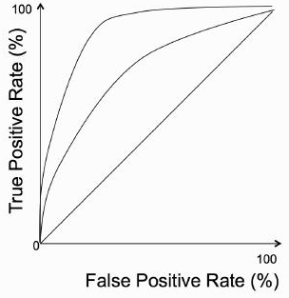
An example of an ROC curve.
The diagonal line represents exactly chance,
so anything above the line is better than chance, and the further from the line, the better.
Of the two curves shown, the one that is further away from the diagonal line would represent a more accurate method.

Slide 31
In order to compare classifiers, or choices of parameters settings for the same classifier, you could just compute the point that is furthest from the ‘chance’ line along the diagonal.
However, it is normal to compute the area under the curve (AUC) instead.
The key to getting a curve rather than a point on the ROC curve is to use cross-validation.

Slide 32
If you use 10-fold cross-validation, then you have 10 classifiers, with 10 different test sets, and you also have the ‘ground truth’ labels.
ground truth means true positive
The true labels can be used to produce a ranked list of the different cross-validation-trained results, which can be used to specify a curve through the 10 data points on the ROC curve that correspond to the results of this classifier.
By producing an ROC curve for each classifier it is possible to compare their results.

Slide 33
2.2.6 Unbalanced Datasets
for the accuracy, we have implicitly assumed that there are the same number of positive and negative examples in the dataset (which is known as a balanced dataset).
In the case where it is not a balanced dataset, we can compute the balanced accuracy as the sum of sensitivity and specificity divided by 2.

Slide 34
a more correct measure is Matthew's Correlation Coefficient, which is computed as:
If any of the brackets in the denominator are 0, then the whole of the denominator is set to 1.
This provides a balanced accuracy computation.
if there are more than two classes, you use one class as the positives and everything else as the negatives, and repeat this for each of the different classes.

Slide 35
2.2.7 Measurement Precision
The concept 'Precision' here is to treat the machine learning algorithm as a measurement system.
Even before comparing outputs to the target values, we can measure something about the algorithm:
if we feed in a set of similar inputs, then we would expect to get similar outputs for them.
This measure of the variability of the algorithm is also known as precision,
and it tells us how repeatable the predictions that the algorithm makes are.
think of precision as being something like the variance of a probability distribution:
it tells you how much spread around the mean to expect.

Slide 36
how well the algorithm's predictions match reality is known as trueness, and it can be defined as
the average distance between the correct output and the prediction.
Trueness doesn't usually make much sense for classification problems

Slide 37
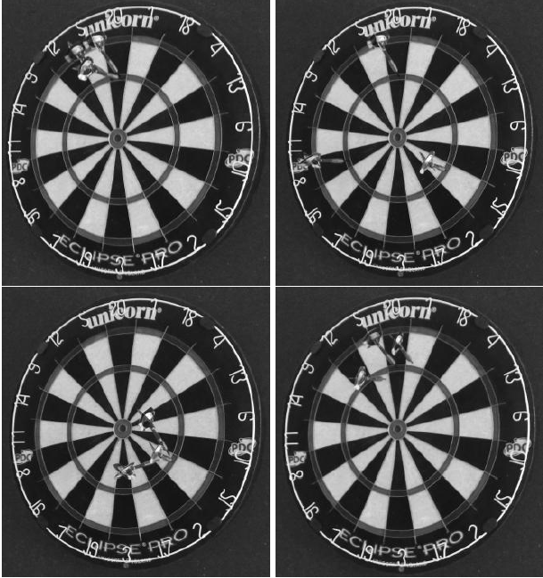
Top left: very accurate: high precision and trueness,
top right: low precision, but good trueness,
bottom left: high precision, but low trueness,
and bottom right: reasonable trueness and precision, but the actual outputs are not very good.

Slide 38
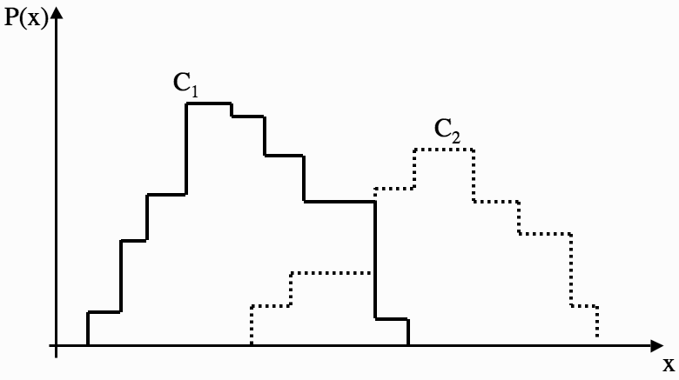
2.3 TURNING DATA INTO PROBABILITIES
A histogram of feature values (x) against their probability for two classes.
given a training set of values of x and the class that each exemplar belongs to.
calculate the value of P(C₁)
we just count how many times out of the total the class was C₁ and divide by the total number of examples

Slide 39
the conditional probability of C₁ given that x has value X: P(C₁|X) .
The conditional probability tells us
how likely it is that the class is C₁ given that the value of x is X.
how to get to this conditional probability P(C₁|X), since we can't read it directly from the histogram.
The first: to get these values is to quantise the measurement x,
which just means that we put x into one of a discrete set of values {X}, such as the bins in a histogram.
To compute P(C_{i},X_{j}), which is the joint probability
tells us how often a measurement of C_{i} fell into histogram bin X_{j} .
We do this by looking in histogram bin X_{j} , counting the number of examples of class C_{i} that are in it, and dividing by the total number of examples (of any class).

Slide 40
P(X_{j} |C_{i}),
how often (in the training set) there is a measurement of X_{j} given that the example is a member of class C_{i}.
by counting the number of examples of class C_{i} in histogram bin X_{j} and dividing by the number of examples of that class C_{i} there are (in any bin).
So we have now worked out two things from our training data:
the joint probability P(C_{i},X_{j}) and the conditional probability P(X_{j} |C_{i}).
Since we actually want to compute P(C_{i}|X_{j})

Slide 41
Bayes' rule,
P(C_{i},X_{j}) = P(X_{j} |C_{i})P(C_{i})
or equivalently: P(C_{i},X_{j}) = P(C_{i}|X_{j})P(X_{j}).

Slide 42
Bayes' rule relates the posterior probability P(Ci|Xj) with the prior probability P(Ci) and class-conditional probability P(Xj |Ci).
The denominator P(X_{j}) acts to normalise everything, so that all the probabilities sum to 1.
any observation Xk has to belong to some class Ci, then we can marginalise over the classes to compute:

Slide 43
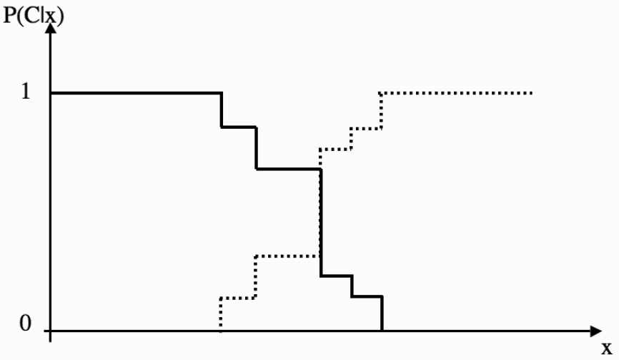
The posterior probabilities of the two classes C1 and C2 for feature x.

Slide 44
We can use the posterior probability to assign each new observation to one of the classes by picking the class Ci where:
P(Ci|x) > P(Cj |x) i ≠ j
where x is a vector of feature values
This is known as the maximum a posteriori or MAP hypothesis,
and it gives us a way to choose which class to choose as the output one.

Slide 45
The MAP question is
what is the most likely class given the training data?
Another method
where we take into account the final outcomes of all of the classes is called the Bayes' Optimal Classification.
It minimises the probability of misclassification, rather than maximising the posterior probability.

Slide 46
2.3.1 Minimising Risk
loss matrix
that specifies the risk involved in classifying an example of class Ci as class Cj .
It looks like the confusion matrix , except that a loss matrix always contains zeros on the leading diagonal since there should never be a loss from getting the classification correct!
Once we have the loss matrix, we just extend our classifier to minimise risk by multiplying each case by the relevant loss number.

Slide 47
2.3.2 The Naïve Bayes' Classifier
suppose that the vector of feature values had many elements, so that there were lots of different features that were measured.
P(X_{j} |C_{i}) = P(X¹_{j} ,X²_{j} , . . .X^{n}_{j} |Ci)
As the dimensionality of X increases (as n gets larger), the amount of data in each bin of the histogram shrinks.
This is the curse of dimensionality again, and means that we need much more data as the dimensionality increases.
We can assume that
the elements of the feature vector are conditionally independent of each other, given the classification.
So given the class Ci, the values of the different features do not affect each other.
This is the naïveté

Slide 48
is just equal to
So the classifier rule for the naïve Bayes' classifier is to select the class Ci for which the following computation is the maximum:

Slide 49
This is clearly a great simplification over evaluating the full probability, so it might come as a surprise that the naïve Bayes’ classifier has been shown to have comparable results to other classification methods in certain domains.

Slide 50
2.4 SOME BASIC STATISTICS
2.4.1 Averages
the mean and the variance
The mean is the most commonly used average of a set of data,
There are two other averages that are used: the median and the mode.
The median is the middle value, to sort the dataset according to size and then find the point that is in the middle
faster algorithm for computing the median based on a randomised algorithm
The mode is the most common value, so it just requires counting how many times each element appears and picking the most frequent one.

Slide 51
2.4.2 Variance and Covariance
Expectation consists of multiplying together the random value for each possibility with the probability of that thing happening, and then adding them all together.
The variance of the set of numbers is a measure of how spread out the values are.
It is computed as the sum of the squared distances between each element in the set and the expected value of the set (the mean, μ):

Slide 52
The square root of the variance, σ, is known as the standard deviation.
Covariance is a measure of how dependent the two variables are (in the statistical sense).
It is computed by:
cov({xi}, {yi}) = E({xi} − μ)E({yi} −ν)
If two variables are independent, then the covariance is 0 (the variables are then known as uncorrelated).

Slide 53
the covariance matrix
where x_{i} is a column vector describing the elements of the ith variable, and μ_{i} is their mean.

Slide 54
the covariance matrix is square
the elements on the leading diagonal of the matrix are equal to the variances
it is symmetric since cov(xi, xj) = cov(xj , xi).
be written in matrix form as Σ= E[(X−E[X])(X−E[X])^{T} ]

Slide 55
If the data is tightly controlled then the test point has to be close to the mean,
while if the data is very spread out, then the distance of the test point from the mean does not matter as much.
We can use this to construct a distance measure that takes this into account.
It is called the Mahalanobis distance

Slide 56
If we set the covariance matrix to the identity matrix, then the Mahalanobis distance reduces to the Euclidean distance.
Probability distribution describes the probabilities of something occurring over the range of possible feature values.

Slide 57
2.4.3 The Gaussian
The probability distribution that is most well known is the Gaussian or normal distribution.
The Gaussian distribution turns up in many problems because of the Central Limit Theorem,
which says that lots of small random numbers will add up to something Gaussian.

Slide 58
In higher dimensions d, |Σ| being its determinant.

Slide 59
in two dimensions of three different cases:
when the covariance matrix is the identity;
when there are only numbers on the leading diagonal of the matrix;
and the general case.
The first case is known as a spherical covariance matrix, and has only 1 parameter.
The second and third cases define ellipses in two dimensions,
either aligned with the axes (with n parameters) or more generally, with n² parameters.

Slide 60
2.5 THE BIAS-VARIANCE TRADEOFF
Whenever we train any type of machine learning algorithm
we are making some choices about a model to use,
and fitting the parameters of that model.
The more degrees of freedom the algorithm has, the more complicated the model that can be fitted.
The more complicated models have inherent dangers such as
overfitting,
and requiring more training data,
and we have seen the need for validation data to ensure that the model does not overfit.

Slide 61
bias-variance dilemma
A model can be bad for two different reasons.
Either it is not accurate and doesn't match the data well,
or it is not very precise and there is a lot of variation in the results.
The first of these is known as the bias,
while the second is the statistical variance.
More complex classifiers will tend to improve the bias, but the cost of this is higher variance, while making the model more specific by reducing the variance will increase the bias.
Some models are definitely better than others, but choosing the complexity of the model is important for getting good results.

Slide 62
to compute the error between the targets and the predicted outputs is to sum up the squares of the difference between the two.
sum-of-squares error function can split up into separate pieces that represent the bias and the variance.
Suppose that the function that we are trying to approximate is y=f(x)+ε, where ε is the noise, which is assumed to be Gaussian with 0 mean and variance σ².
a hypothesis h(x) = w^{T}x + b (where w is the weight vector) to the data in order to minimise the sum-of-squares error Σ_{i}(y_{i} − h(x_{i}))².

Slide 63
In order to decide whether or not our method is successful
we need to consider it on independent data,
so we consider a new input x* and compute the expected value of the sum-of squares error, which we will assume is a random variable.
The fact: E[(Z − ~Z)²] = E[Z² − 2Z ~Z + ~Z²]
= E[Z²] − 2E[Z]~ Z +~ Z²
= E[Z2] − 2 ~ Z~ Z + ~Z²
= E[Z²] − ~Z².
E[Z²]= E[(Z − ~Z)²]+ ~Z²

Slide 64
E[(y* − h(x*))²] = E[y*² − 2y*h(x*) + h(x*)²]
= E[y*²] − 2E[y*h(x*)] + E[h(x*)²]
= E[(y* − f(x*))²] + f(x*)² + E[(h(x*) −~h(x*))²]+~h(x*)² − 2f(x*)~h(x*)
= E[(y* − f(x*))²] + E[(h(x*) −~h(x*))²] + (f(x*) -~h(x*))²
= noise² + variance + bias².
Noise is the irreducible error and is the variance of the test data.
The variance tells us how much h(x*) changes depending on the particular training set x*that was used,
while the bias tells us about the average error of h(x*).

Slide 65
you can have a model with low bias (meaning that on average the outputs are current), but high variance (meaning that the answers wibble around all over the place) or vice versa.
but you can’t make them both zero – for each model there is a tradeoff between them.
However, for any particular model and dataset there is some reasonable set of parameters that will give the best results for the bias and variance together, and part of the challenge of model fitting is to find this point.

